Slide 1
ITP eLog
https://ipp.sit.nyp.edu.sg/IPPStudportal/
Use your SIT Domain account ID and password to login.
• Read the “eLog Guide” on the Home page before you start using the system.
• Once you have started entering the tasks in the system, an email will be sent to your IIM informing him of the login id & password. The email contains URL of the system for them to review your task. FYI, the URL is https://ipp.sit.nyp.edu.sg/ippweb
(Note that this is different from yours.)
• One important thing to note is that you need to use the function “Submit Tasks” to submit the tasks you’d entered in order for your IIM/SIM to read them. Tasks submitted cannot be changed and therefore, please be careful when using this function.

Slide 2
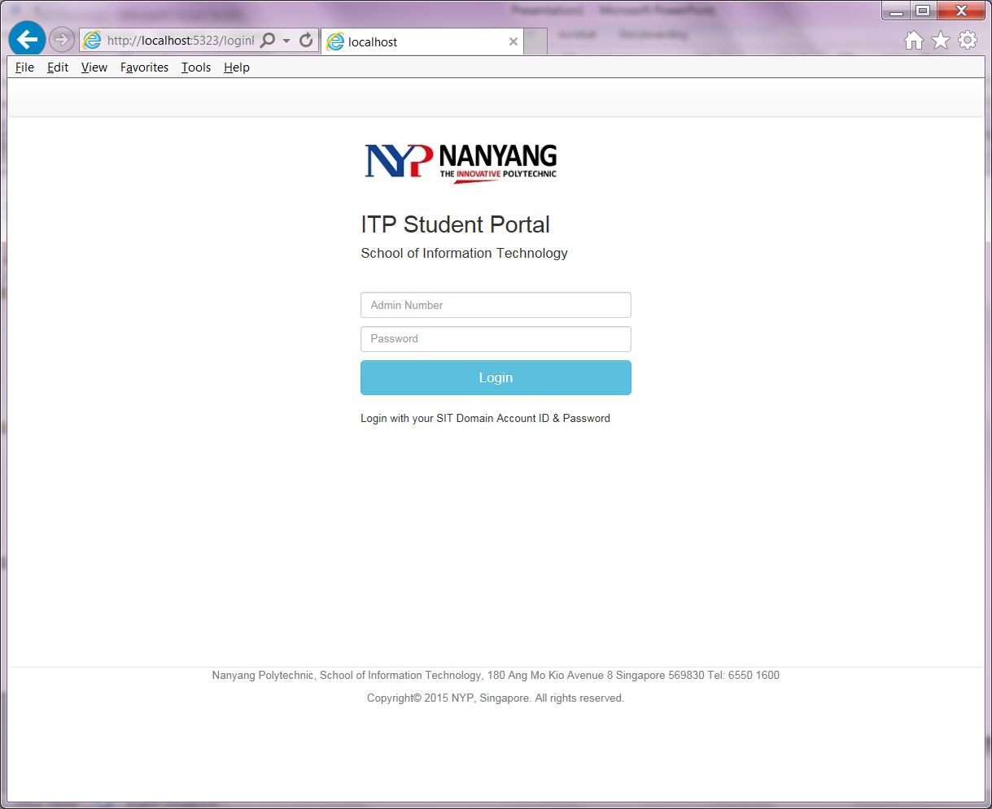

Slide 3
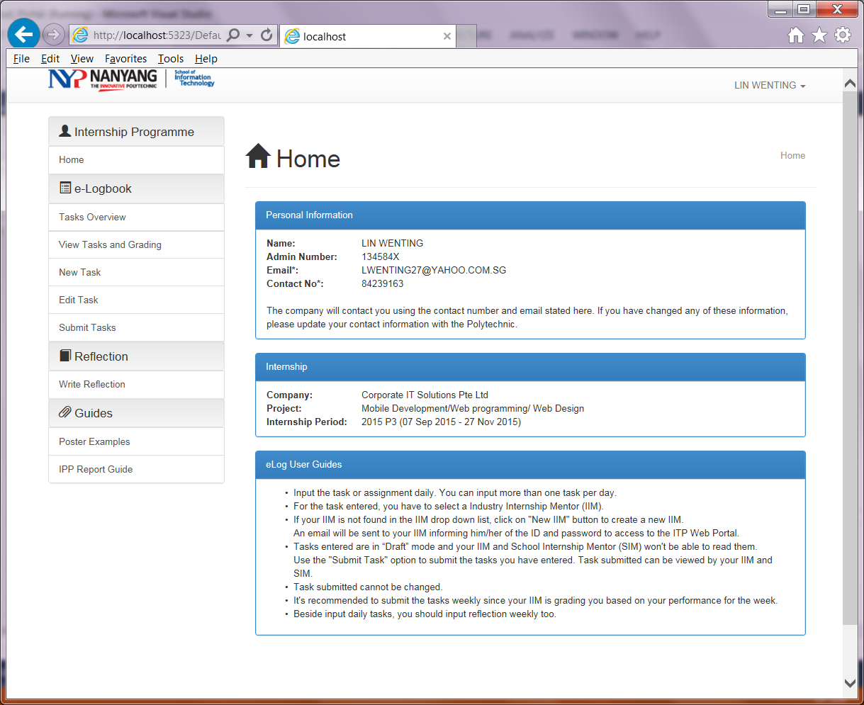

Slide 4
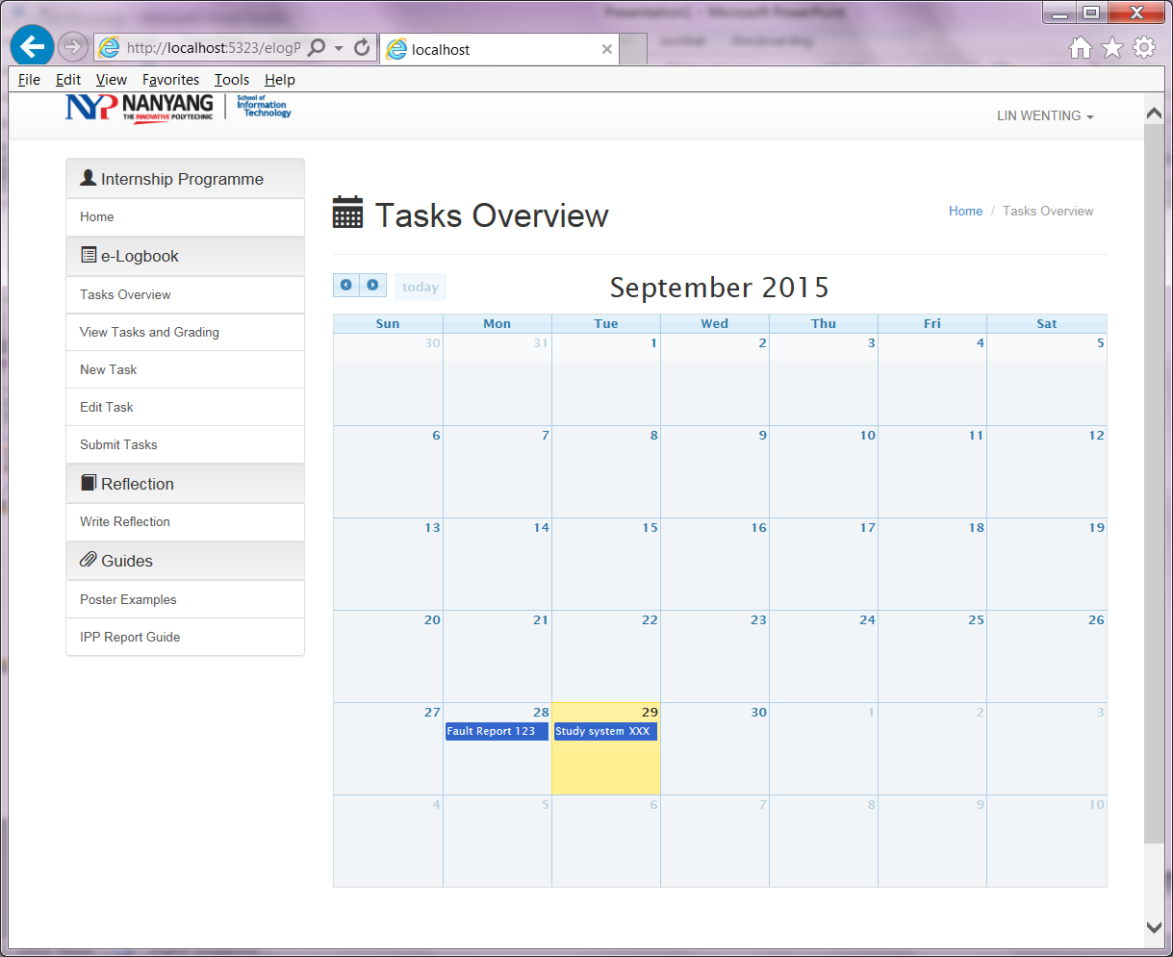

Slide 5
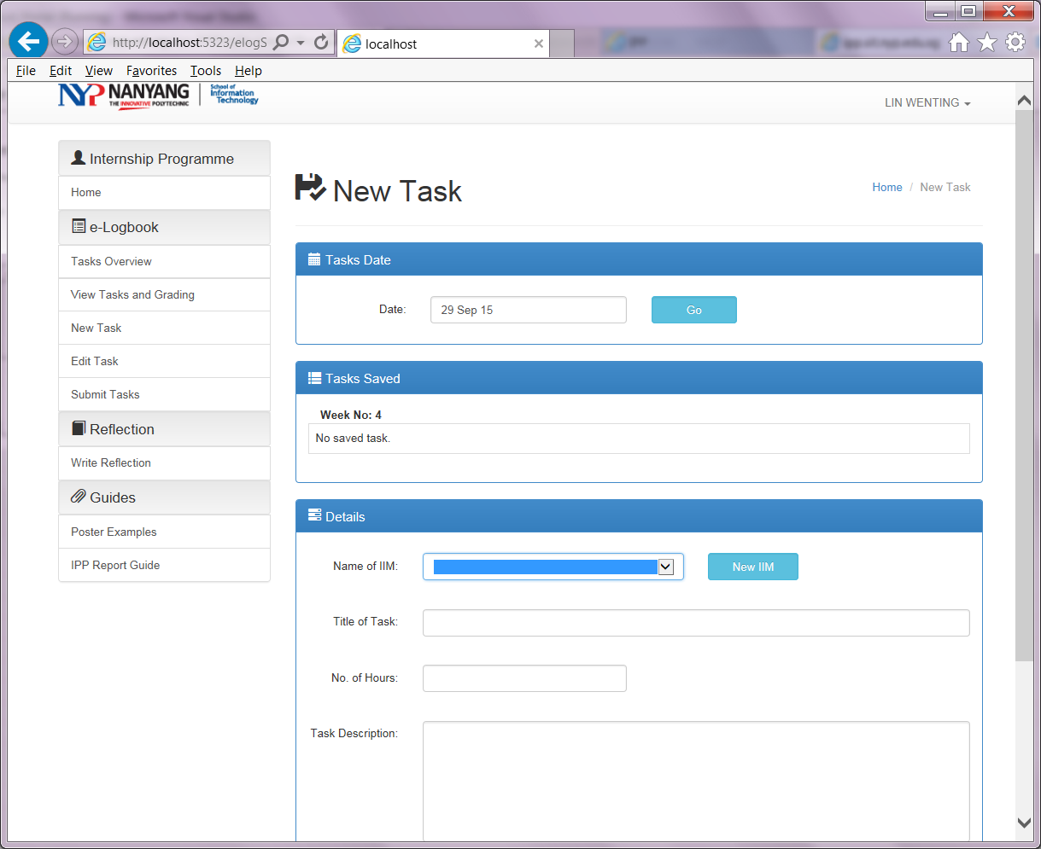

Slide 6
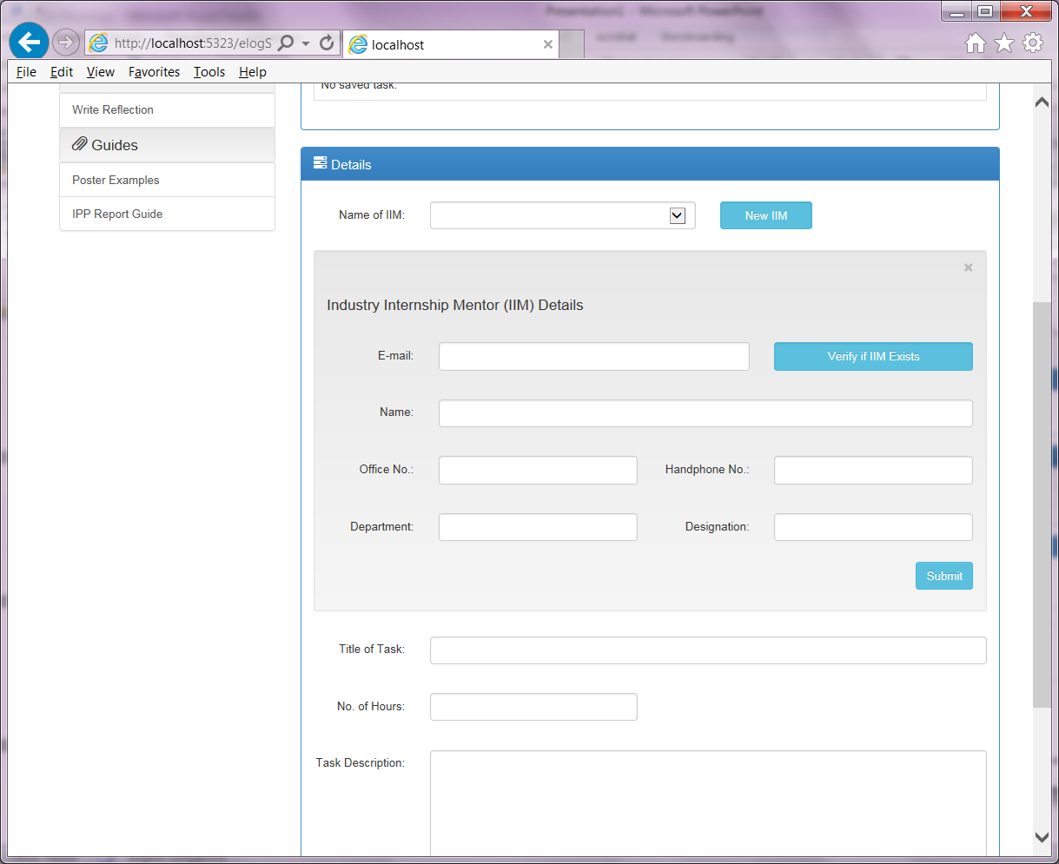
Student enter IIM details (only if IIM record not found)

Slide 7
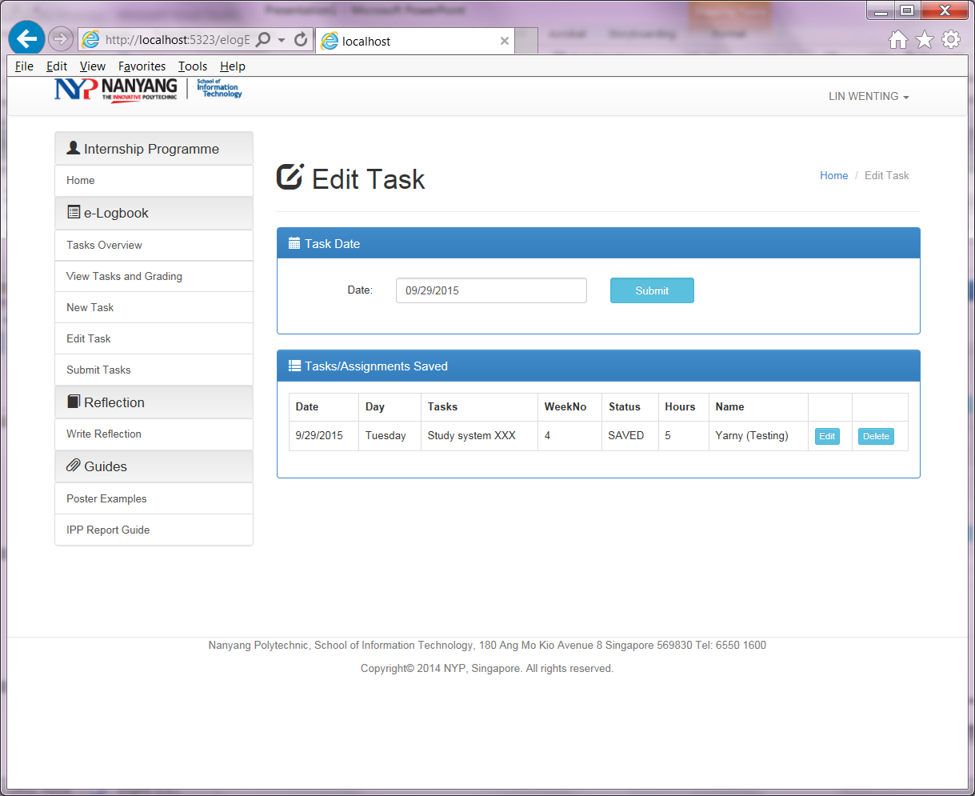

Slide 8
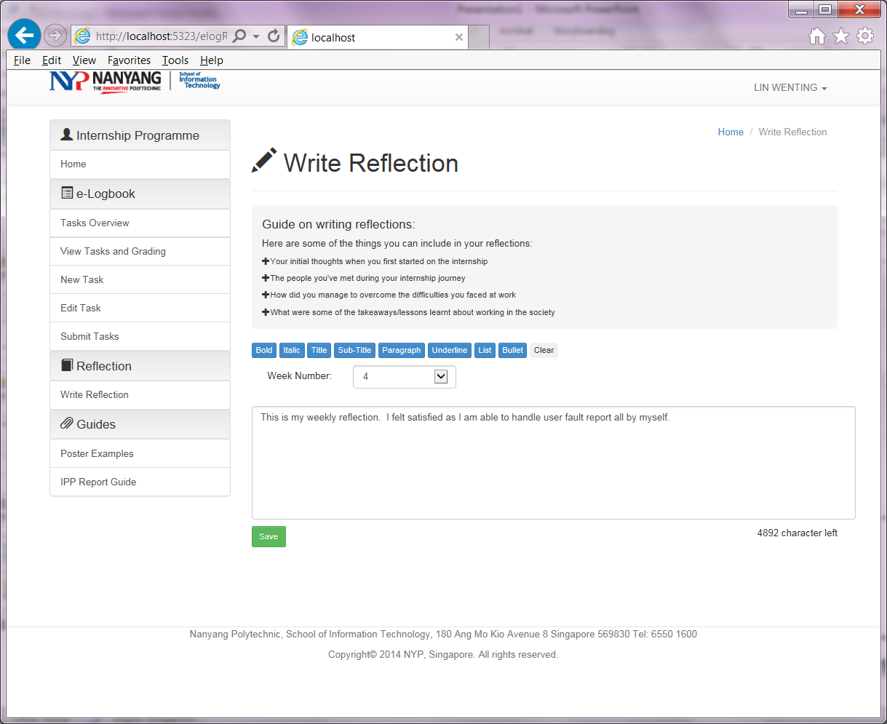

Slide 9
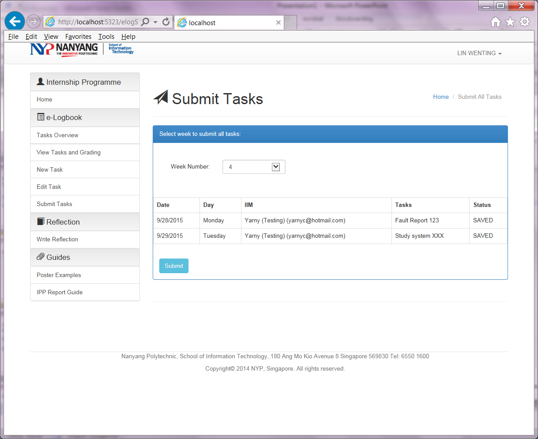

Slide 10
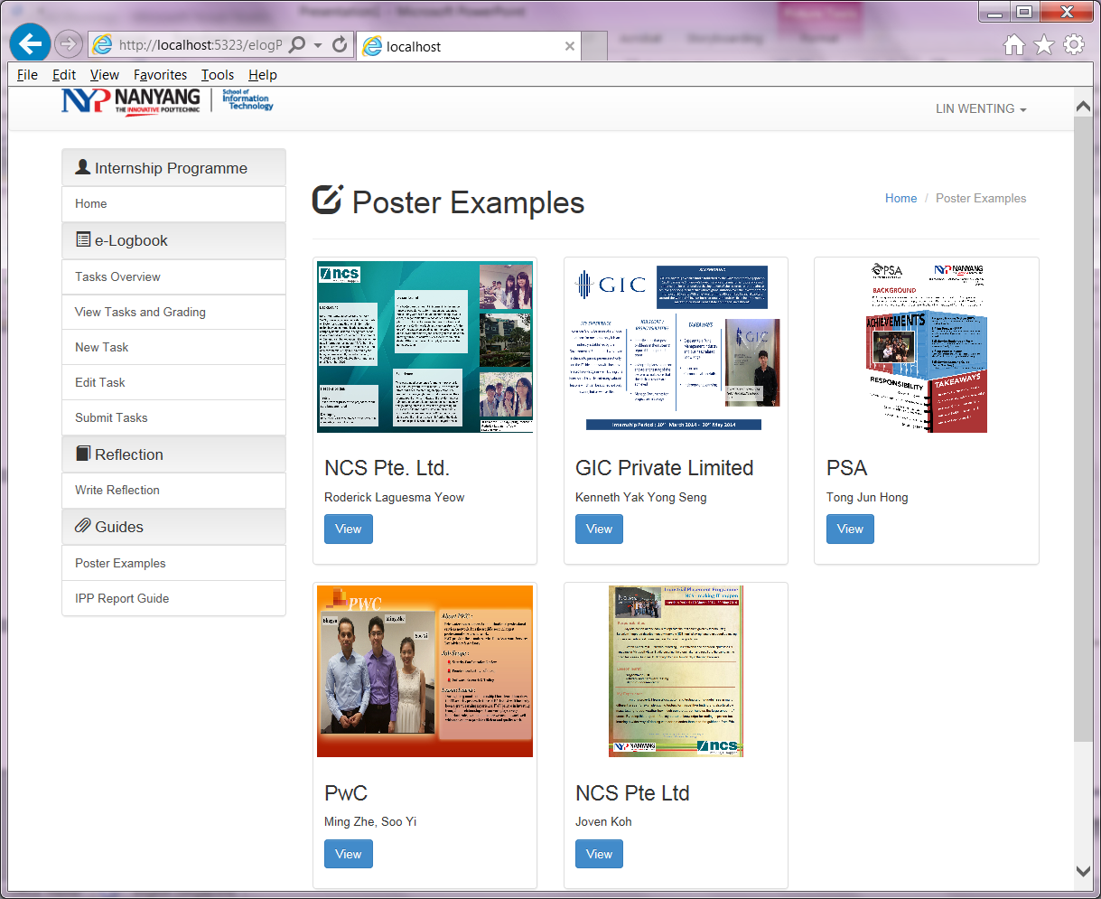

Slide 11
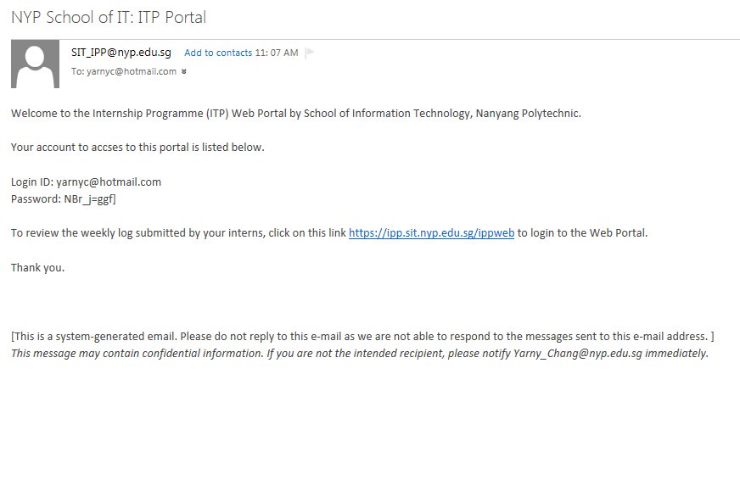
Email sent to IIM

